Slide 1
A systematics implementation of AI- Enhanced Central Library system with Chatbot.
Presented by :
Shlok Thete
T.E. CSE(AIML)
PIN: Semester-V
Guided By :

Slide 2
CONTENTS
Aim
Abstract
Introduction
Problem definition
Problem Solution
Future scope
Hardware and software requirements
System architecture
Project Method
Features
Advantages
Conclusion
References

Slide 3
AIM
To develop Digital Library System.
To create an efficient and user-friendly online Digital Library Systemthat streamlines library operations, enhances accessibility to digital and physical resources, facilitates seamless borrowing and returning of materials, and provides valuable data insights for informed decision-making, ultimately improving the overall library experience for both staff and patrons.

Slide 4
ABSTRACT
Digital Library System is a project which aims in developing a computerized system to maintain all the daily work of library .This project has many features which are generally not available in normal library management systems like facility of user login and a facility of admin login. It also has a facility of admin login through which the admin can monitor the whole system. It has also a facility where student after logging in their accounts can see list of books issued and its issue date and return date. Traditional Libraries can be turned into digital libraries using the Digital Library System(LMS). LMS allows a user to maintain a library efficiently and keep records of the books and customers accurately. The biggest advantage of LMS is it saves time and money and needs less human interaction. The purpose of the thesis is to develop a LMS system, which can perform basic tasks of a library. Overall this project of ours is being developed to help the students as well as staff of library to maintain the library in the best way possible and also reduce the human efforts.

Slide 5
INTRODUCTION
Digital Library System is a web based application. Digital Library Systemis a project which aims in developing a computerized system to maintain all the daily work of library. This project has many features which are generally not available in normal library management systems like facility of user login and a facility of admin login. It also has a facility of admin login through which the admin can monitor the whole system. It has also a facility where student after logging in their accounts can see list of books issued and its issue date and return date. The main purpose of the project is to is to build an online LMS system by using different software methodologies. The author designed the LMS with the basic and necessary features like the admin/librarian can add/delete book, can add/delete author, can issue books, can manage books and users, and users/students can search and borrow books. For Frontend part of the project the author used HTML, CSS, JavaScript and Bootstrap framework and for the Backend part the author used PHP and MySQL database.

Slide 6
PROBLEM DEFINITION
File lost When computerized system is not implemented file is always lost because of human environment. Some times due to some human error there may be a loss of records.
File damaged When a computerized system is not there file is always lost due to some accident like spilling of water by some member on file accidentally. Besides some natural disaster like floods or fires may also damage the files.
Difficult to search record When there is no computerized system there is always a difficulty in searching of records if the records are large in number .
Space consuming After the number of records become large the space for physical storage of file and records also increases if no computerized system is implemented.
Cost consuming As there is no computerized system the to add each record paper will be needed which will increase the cost for the management of library.

Slide 7
PROBLEM SOLUTION
Improvement in control and performance The system is developed to cope up with the current issues and problems of library .The system can add user, validate user and is also bug free.
Save cost After computerized system is implemented less human force will be required to maintain the library thus reducing the overall cost.
Save time Librarian is able to search record by using few clicks of mouse and few search keywords thus saving his valuable time.

Slide 8
FUTURE SCOPE
This website provides a computerized version of Digital Library System which will benefit the students as well as the staff of the library.
It makes entire process online where student can search books, staff can generate reports and do book transactions. It also has a facility for student login where student can login and can see status of books issued.

Slide 9
HARDWARE REQUIREMENT
Processor : Pentium Processor
Ram : 2Gb
Hard Disk : 128Gb
Input device : Standard Keyboard and Mouse.
Output device : Laptop Display

Slide 10
SOFTWARE REQUIREMENTS
OS:- Windows, Linux, Android.
High speed internet.
Browser.

Slide 11
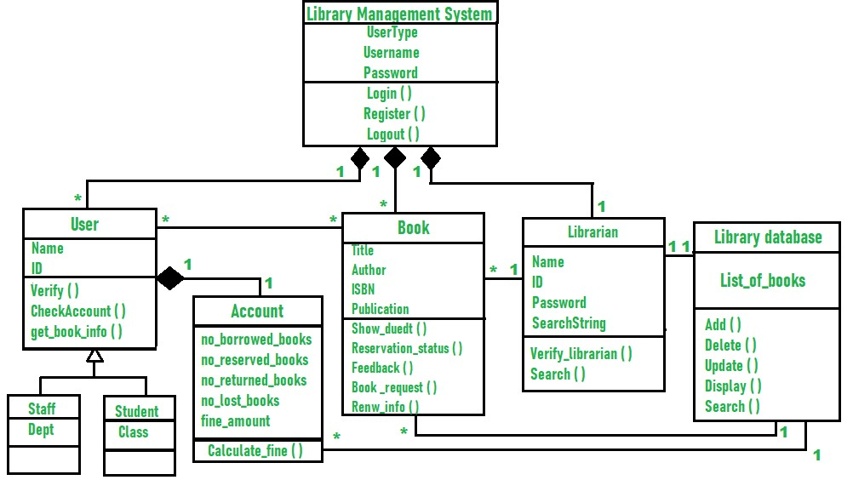
SYSTEM ARCHITECTURE

Slide 12
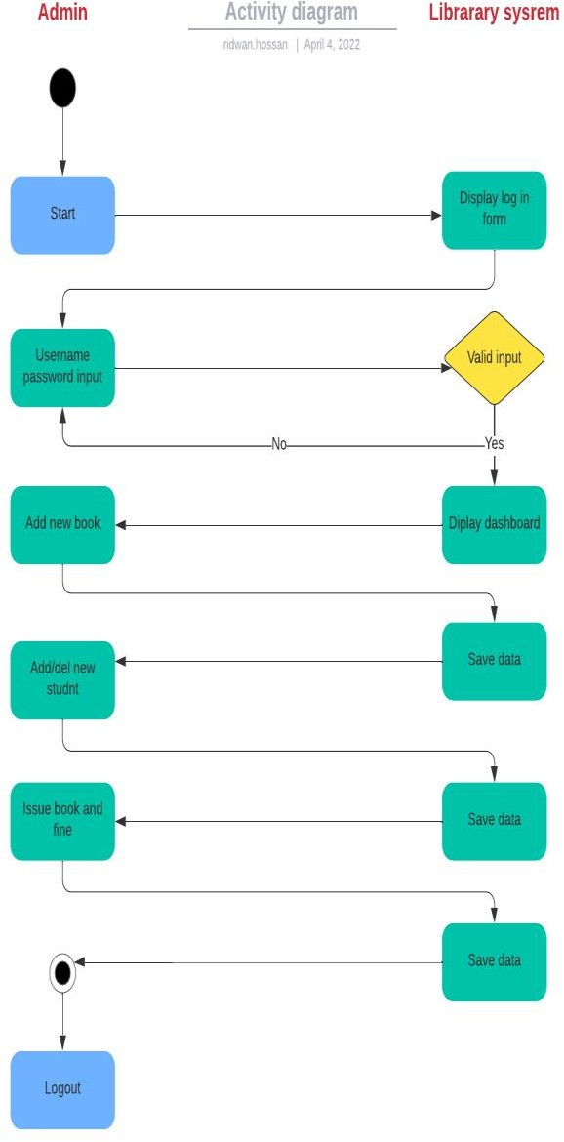
PROJECT METHOD
Admin activity diagram :-

Slide 13
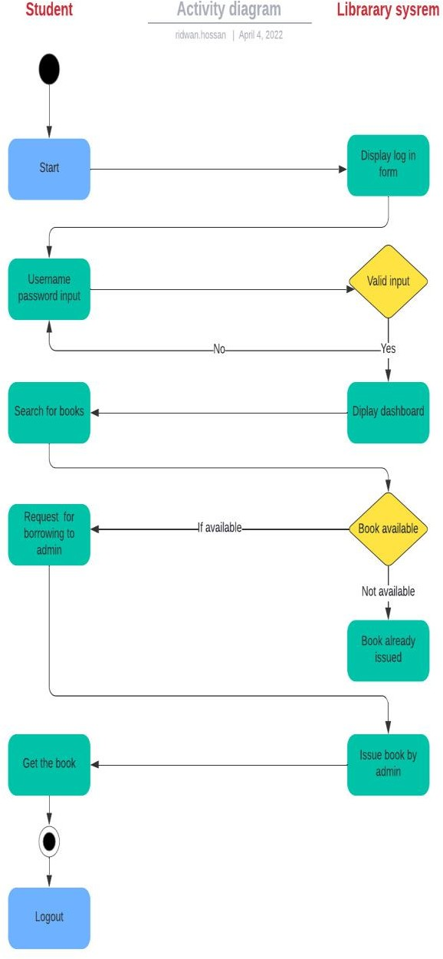
PROJECT METHOD
User activity diagram :-

Slide 14
Features
UI Redesign.
Shelf Number
Digital Copy Access
Fine mnagement

Slide 15
UI Redesign.
Updated user interface to enhance usability and aesthetics.
Streamlined navigation and improved layout for easier browsing.
Integration of modern design elements and responsive design for optimal viewing across devices.

Slide 16
Shelf Number
Introduction of a new feature allowing users to access shelf numbers for physical books.
Seamless integration into the website's interface for easy access during browsing.
Enhanced user experience by facilitating quicker book location and retrieval.

Slide 17
Digital Copy Access
Introduction of digital copy access feature, enabling users to view or download digital copies of books.
Convenient access to digital resources, providing flexibility for users to read offline or on digital devices.
Integration of secure access controls to ensure copyright compliance and protect intellectual property.

Slide 18
Fine Management:
Implementation of fine management system for handling late book returns.
Automated calculation of fines based on predefined rules and policies.
User notification system to alert users about overdue books and pending fines.

Slide 19
ADVANTAGES
Helps streamline day-to-day library operations.
Simple and easy to use.
Slashes down the operating costs.
Time and effort saver:

Slide 20
CONCLUSION
We have successfully designed a Digital Library Systemusing HTML, CSS, JAVASCRIPT, PHP, and MySQL with a decent UI. The thesis project is focused on the development of a system that is both efficient and user-friendly when it comes to providing library management services to users. To achieve the goal, the author used PHP, MySQL, JavaScript Bootstrap, and so on. The challenging part of the project is to design and implement the database. After overcoming the challenges, the author successfully implemented the project and tested its necessary functionalities. All the basic functionality testing is successful which the author planned to do in the LMS. The project is in the prototype stage and it's not fullay ready for actual use, as there is a need to add more functionalities to ensure a good user experience.

Slide 21
REFERENCES
Adamson and Veronica. (2008). JISC & SCONUL Library Management Systems Study. Sheffield, UK: Sero Consulting. p. 51. Retrieved on 06 August 2015.
Ademodi, D.T., & Adepoju, E. O. (2009). Computer skill among Librarians in Academic Libraries on Ondo and Ekiti States, Nigeria. Library Philosophy & Practice.
Adomi, E. E., & Anie, S. O. (2006). An Assessment of Computer Literacy Skills of Professionals in Nigerian University libraries. Library Hi Tech News, Vol.23 (2) pp.10-14.

Slide 22
THANK YOU

